Slide 1
Technology
Adaptive and Assistive Technology
Intended Benefits and Unintended consequences of Technology

Slide 2
Objective
To research bio-engineering and create an infographic presenting our research

Slide 3
Email
Open your personal email account inbox.
If you do not have an email account, you will need to create one if you choose to piktochart.

Slide 4
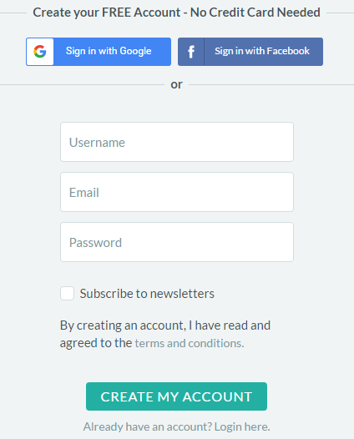
Piktochart
Go to https://piktochart.com/
Create an account using:
Username: student ID
Email: personal email address
Password: your lunch number password

Slide 5
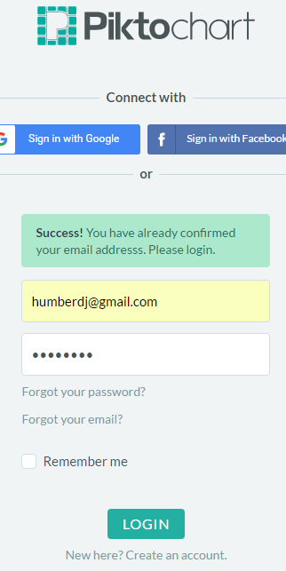
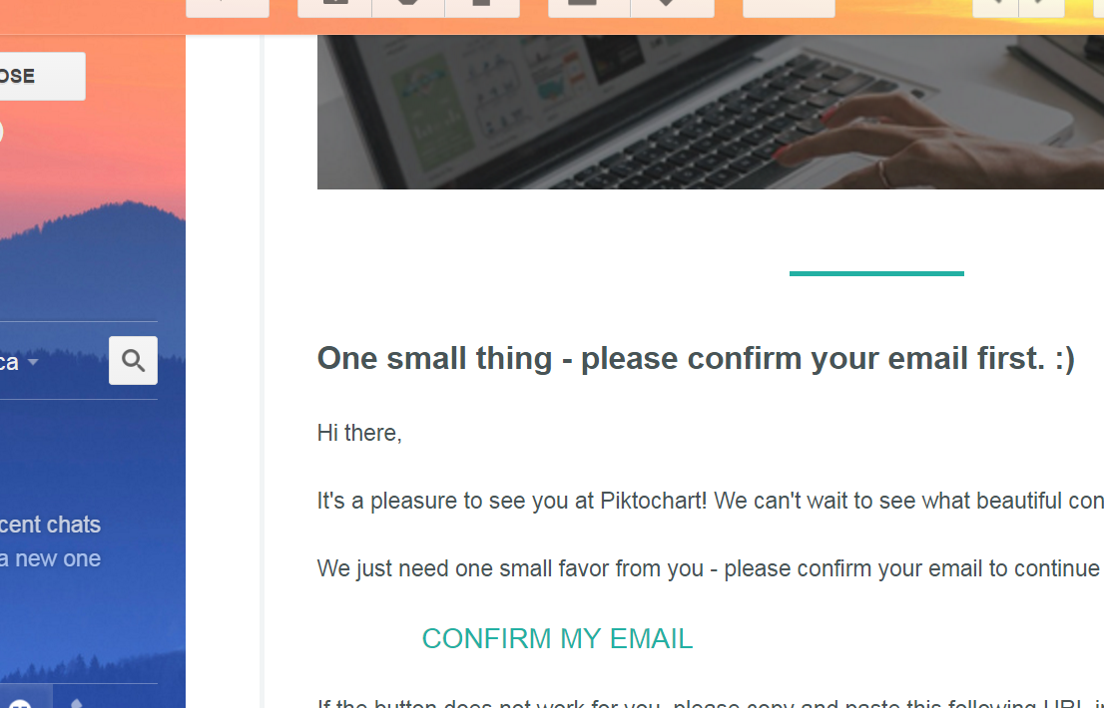
Piktochart
Go back to your email inbox and confirm account for Piktochart by clicking the link in the email.
This will take you back to the Piktochart site to log in with the email and password you used a minute ago.

Slide 6
Piktochart
You are making an INFOGRAPHIC

Slide 7
Piktochart
Select the "Startup Basic" template

Slide 8
RESEARCH PROJECTS
In choosing a topic, you will:
Distinguish between the intended benefits (pros) and the unintended consequences (cons) of the technology.
Describe the role of bioengineering in society.
Topics must be about BIOENGINEERING. Some examples of topics may include:
GMOs and transgenic animals
Cloning
Stem Cell Research
Pest Control
Genetic Engineering
Bioremediation
Biofuels
Bioleaching
Genetic Testing
Pharmacology
DNA Technology and Crime
Antibiotics, Vaccines and Medicines
Reproductive Technology
Industrial Biotechnology
Gene therapy
Genetically modified crops

Slide 9
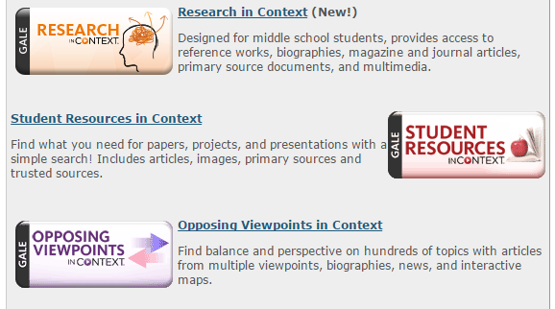
TEL (Tennessee Electronic Library)
Go to: http://tntel.tnsos.org/
Once you have clicked on the TEL, you can use one of these databases:
Research in Context
Student Resources in Context
Opposing Viewpoints
You can browse for topics by subject or search for specific topic ideas.

Slide 10
YOUR PROJECT (Rubric)
Create an Infographic with the following sections and elements :
Appropriate topic (1pt)
Title (1pt)
Subtitle (a short phrase that describes the topic 5-7 words) (1pt)
Overview (summary) (2pts)
Fast facts (2pts)
Benefits of the technology to society (PROS) (2pts)
Costs or consequences of the technology (CONS) (2pt)
Charts, diagrams or visual images that help the audience understand the topic (you may find these within articles or on google) (1pt)
Citations (articles and authors, including links to articles you used for references). (2pts)

