Slide 1
TRANSFORM BOUNDARIES
Iceland has a divergent plate boundary running through its middle
Transform
Traffic
Tree Green
A plate boundary where two tectonic plates are sliding past each other like traffic.
Landforms
Volcanoes
Folded Mountains
Subduction Zones
Trenches
Volcanic Islands
Notes:
Iceland is located right on top of a divergent boundary. In fact, the island exists because of this feature.
As the North American and Eurasian plates were pulled apart (see map) volcanic activity occurred along the cracks and fissures (see photographs).
With many eruptions over time the island grew out of the sea!
Question: Why don’t we have islands like Iceland where ever we get an Ocean Ridge?
Answer: Scientists believe that there is a large mantle plume (an upwelling of hot mantle material) located right underneath where Iceland has formed. This would mean that more material would be erupted in the Iceland area compared with if there was just the divergent boundary without the plume underneath it.

Slide 2
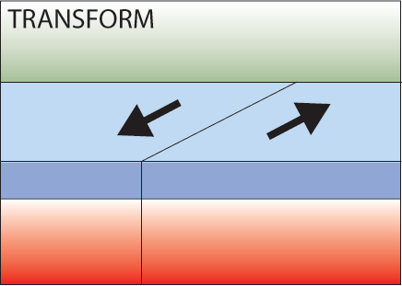
TRANSFORM BOUNDRIES
“TRAFFIC”
Where plates slide past each other
Notes:
The third type of boundary are transform boundaries, along which plates slide past each other.
The San Andreas fault, adjacent to which the US city of San Francisco is built is an example of a transform boundary between the Pacific plate and the North American plate.

Slide 3
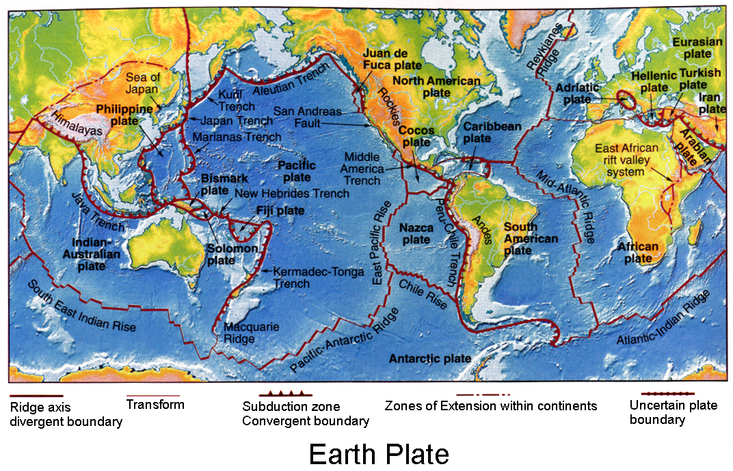
TECTONIC PLATES
Notes:
This map summarises all the known plate boundaries on Earth, showing whether they are divergent, convergent or transform boundaries.

Slide 4
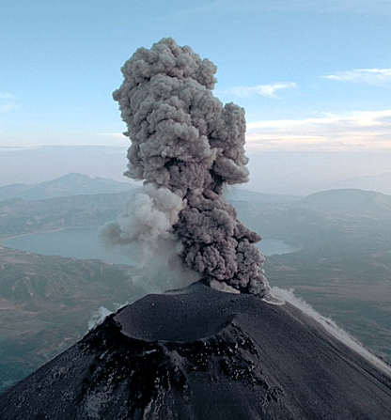
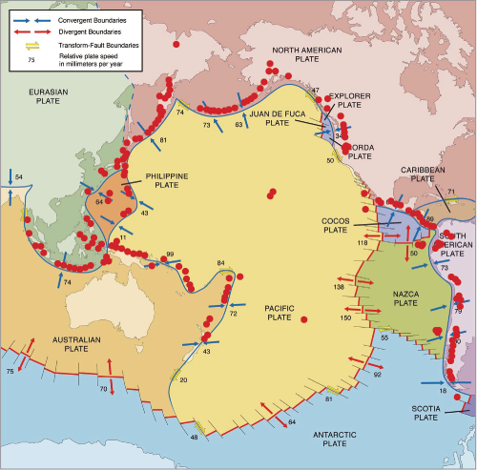
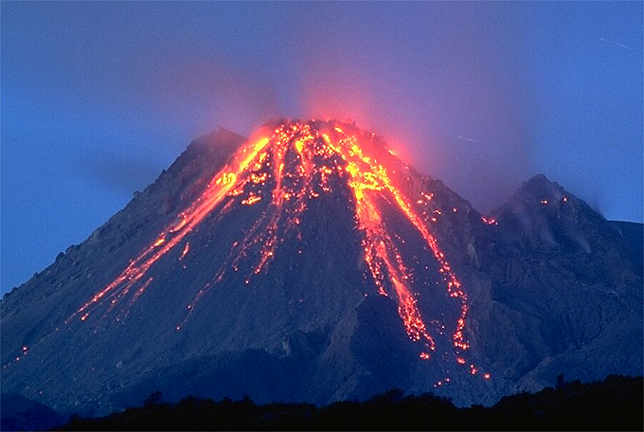
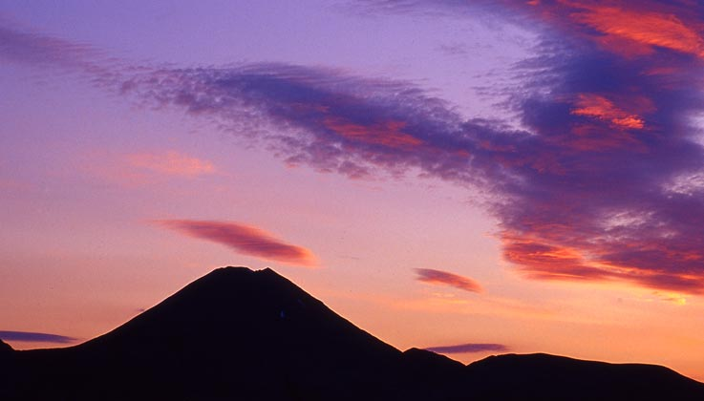
PACIFIC RING OF FIRE
Volcanism is mostly focused at plate margins
Notes:
This map shows the margins of the Pacific tectonic plate and surrounding region. The red dots show the location of active volcanism. Notice how the majority of the volcanism is focused in lines along the plate boundaries? For this region this area is known as the “Pacific Ring of Fire”.
But why are all of the volcanoes located at the plate margins?

Slide 5
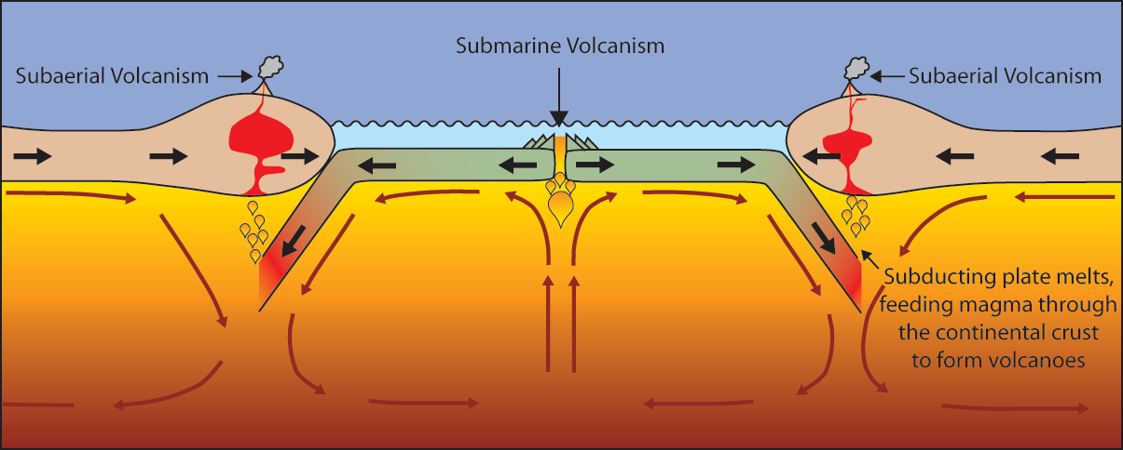
VOLCANOES
Volcanoes are formed by:
Subduction Rifting Hotspots
Notes:
Volcanoes can be formed in three ways:
Via subduction. The subducting slab dehydrates to form new melt that will rise through the crust to be erupted at the surface.
Via rifting. When two plates pull apart magma rises, producing volcanic eruptions at the surface.
At “Hotspots”….hotspot do not necessarily occur along a plate boundary. So hotspot volcanoes can form in the middle of tectonic plates….Click for example.

Slide 6
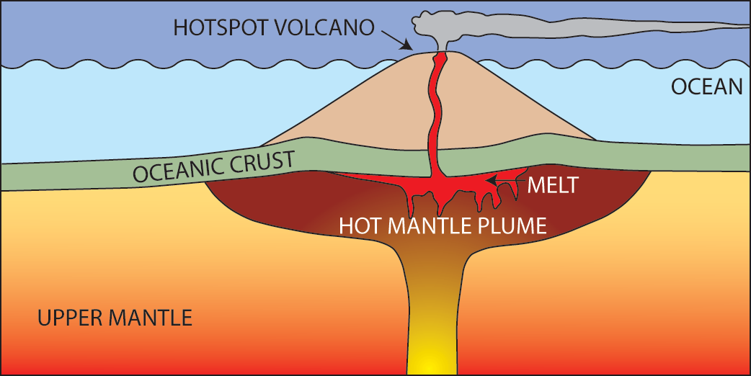
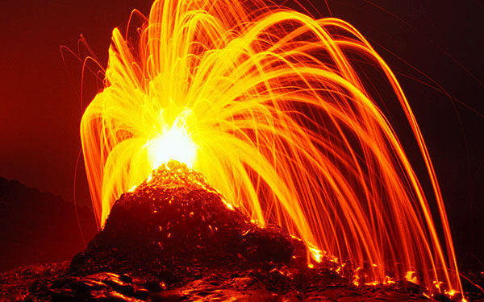
HOTSPOT VOLCANOES
Hot mantle plumes breaching the surface in the middle of a tectonic plate
The Hawaiian island chain are examples of hotspot volcanoes.
Photo: Tom Pfeiffer / www.volcanodiscovery.com
Notes:
Firstly, what are hotspot volcanoes and how do they form?
A hotspot is a location on the Earth's surface that has experienced active volcanism for a long period of time.
The source of this volcanism is a mantle plume of hot mantle material rising up from near the core-mantle boundary through the crust to the surface (see left diagram).
A mantle plume may rise at any location in the mantle, and this is why hotspot volcanoes are independent from tectonic plate boundaries.
The Hawaiian island chain are an example of hotspot volcanoes (see right photograph).

Slide 7
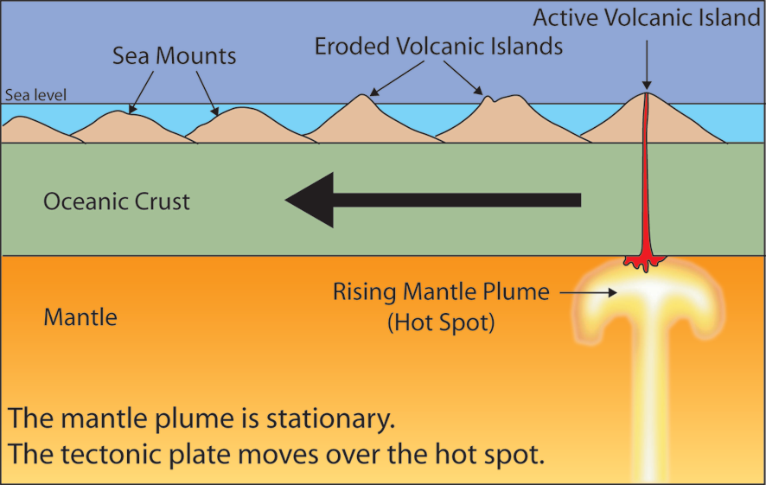
HOTSPOT VOLCANOES
The tectonic plate moves over a fixed hotspot forming a chain of volcanoes.
The volcanoes get younger from one end to the other.
Notes:
Hotspot’s commonly form volcanic island chains (like the Hawaiian islands). These result from the slow movement of a tectonic plate over a FIXED hotspot.
Persistent volcanic activity at a hotspot will create new islands as the plate moves the position of the “old” volcanic island from over the hotspot.
Therefore at one end of the island chain you see the youngest, most active volcanic islands (directly over the hotspot) and along the island chain the extinct volcanoes become older and more eroded (see diagram).
This way geologists can use hotspot volcano chains to track the movement of the tectonic plate through time.

Slide 8
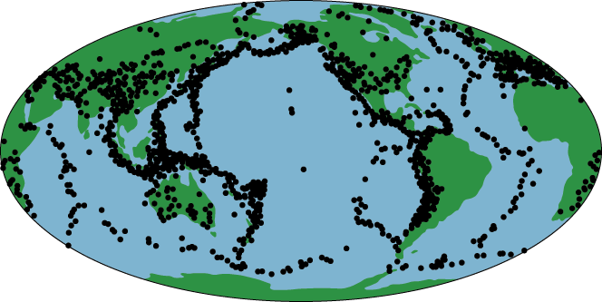
EARTHQUAKES
As with volcanoes, earthquakes are not randomly distributed over the globe.
Figure showing the distribution of earthquakes around the globe
At the boundaries between plates, friction causes them to stick together. When built up energy causes them to break, earthquakes occur.
Notes:
We have seen the connection between volcanoes and plate tectonics.
Is there a connection between earthquakes and plate tectonics?

Slide 9
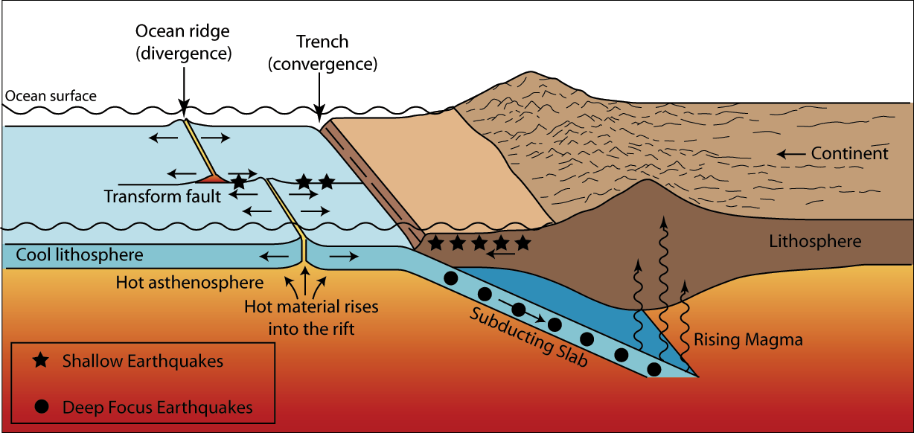
Where do earthquakes form?
EARTHQUAKES
Figure showing the tectonic setting of earthquakes
Notes:
We know there are three types of plate boundaries: Divergent, Convergent and Transform. Movement and slipping along each of these types of boundaries can form an earthquake.
Depending on the type of movement, the earthquakes occur in either a shallow or deep level in the crust.
The majority of tectonic earthquakes originate at depths not exceeding tens of kilometers.
In subduction zones, where old and cold oceanic crust descends beneath another tectonic plate, “Deep Focus Earthquakes” may occur at much greater depths (up to seven hundred kilometers!).
These earthquakes occur at a depth at which the subducted crust should no longer be brittle, due to the high temperature and pressure. A possible mechanism for the generation of deep focus earthquakes is faulting.
Earthquakes may also occur in volcanic regions and are caused there both by tectonic faults and by the movement of magma (hot molten rock) within the volcano. Such earthquakes can be an early warning of volcanic eruptions.

