Slide 1
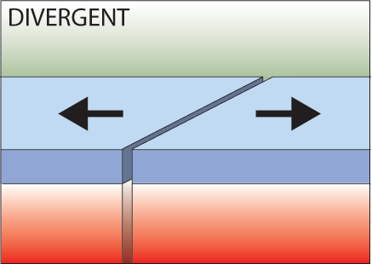
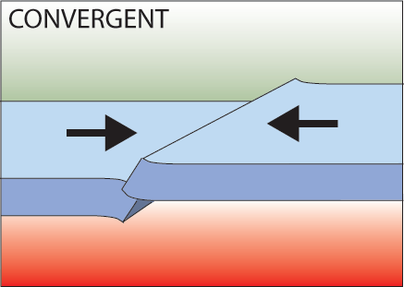
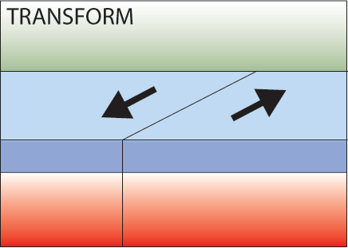
PLATE BOUNDRIES
Three Types of Plate Boundaries
Divergent
Convergent
Transform
Notes:
Firstly, there are three types of plate boundary, each related to the movement seen along the boundary.
Divergent boundaries are where plates move away from each other
Convergent boundaries are where the plates move towards each other
Transform boundaries are where the plates slide past each other.
Presenter: See diagrams for each - it is important to remember the names of the boundary types and the motion involved.

Slide 2
DIVERGENT BOUNDARIES
Iceland has a divergent plate boundary running through its middle
Divergent
Dividing
Dark Blue
A plate boundary where two tectonic plates are pulling away from each other.
Landforms
Rifts
Ridges
New Sea Floor
Sea Floor Spreading
Notes:
Iceland is located right on top of a divergent boundary. In fact, the island exists because of this feature.
As the North American and Eurasian plates were pulled apart (see map) volcanic activity occurred along the cracks and fissures (see photographs).
With many eruptions over time the island grew out of the sea!
Question: Why don’t we have islands like Iceland where ever we get an Ocean Ridge?
Answer: Scientists believe that there is a large mantle plume (an upwelling of hot mantle material) located right underneath where Iceland has formed. This would mean that more material would be erupted in the Iceland area compared with if there was just the divergent boundary without the plume underneath it.

Slide 3
DIVERGENT BOUNDARIES
“DIVIDING”
Notes:
In plate tectonics, a divergent boundary is a linear feature that exists between two tectonic plates that are moving away from each other. These areas can form in the middle of continents or on the ocean floor.
As the plates pull apart, hot molten material can rise up this newly formed pathway to the surface - causing volcanic activity.
Presenter: Reiterate the process by going through the diagram, including the presence of mantle convection cells causing the plates to break apart and also as a source for new molten material.
Where a divergent boundary forms on a continent it is called a RIFT or CONTINENTAL RIFT, e.g. African Rift Valley.
Where a divergent boundary forms under the ocean it is called an OCEAN RIDGE.

Slide 4
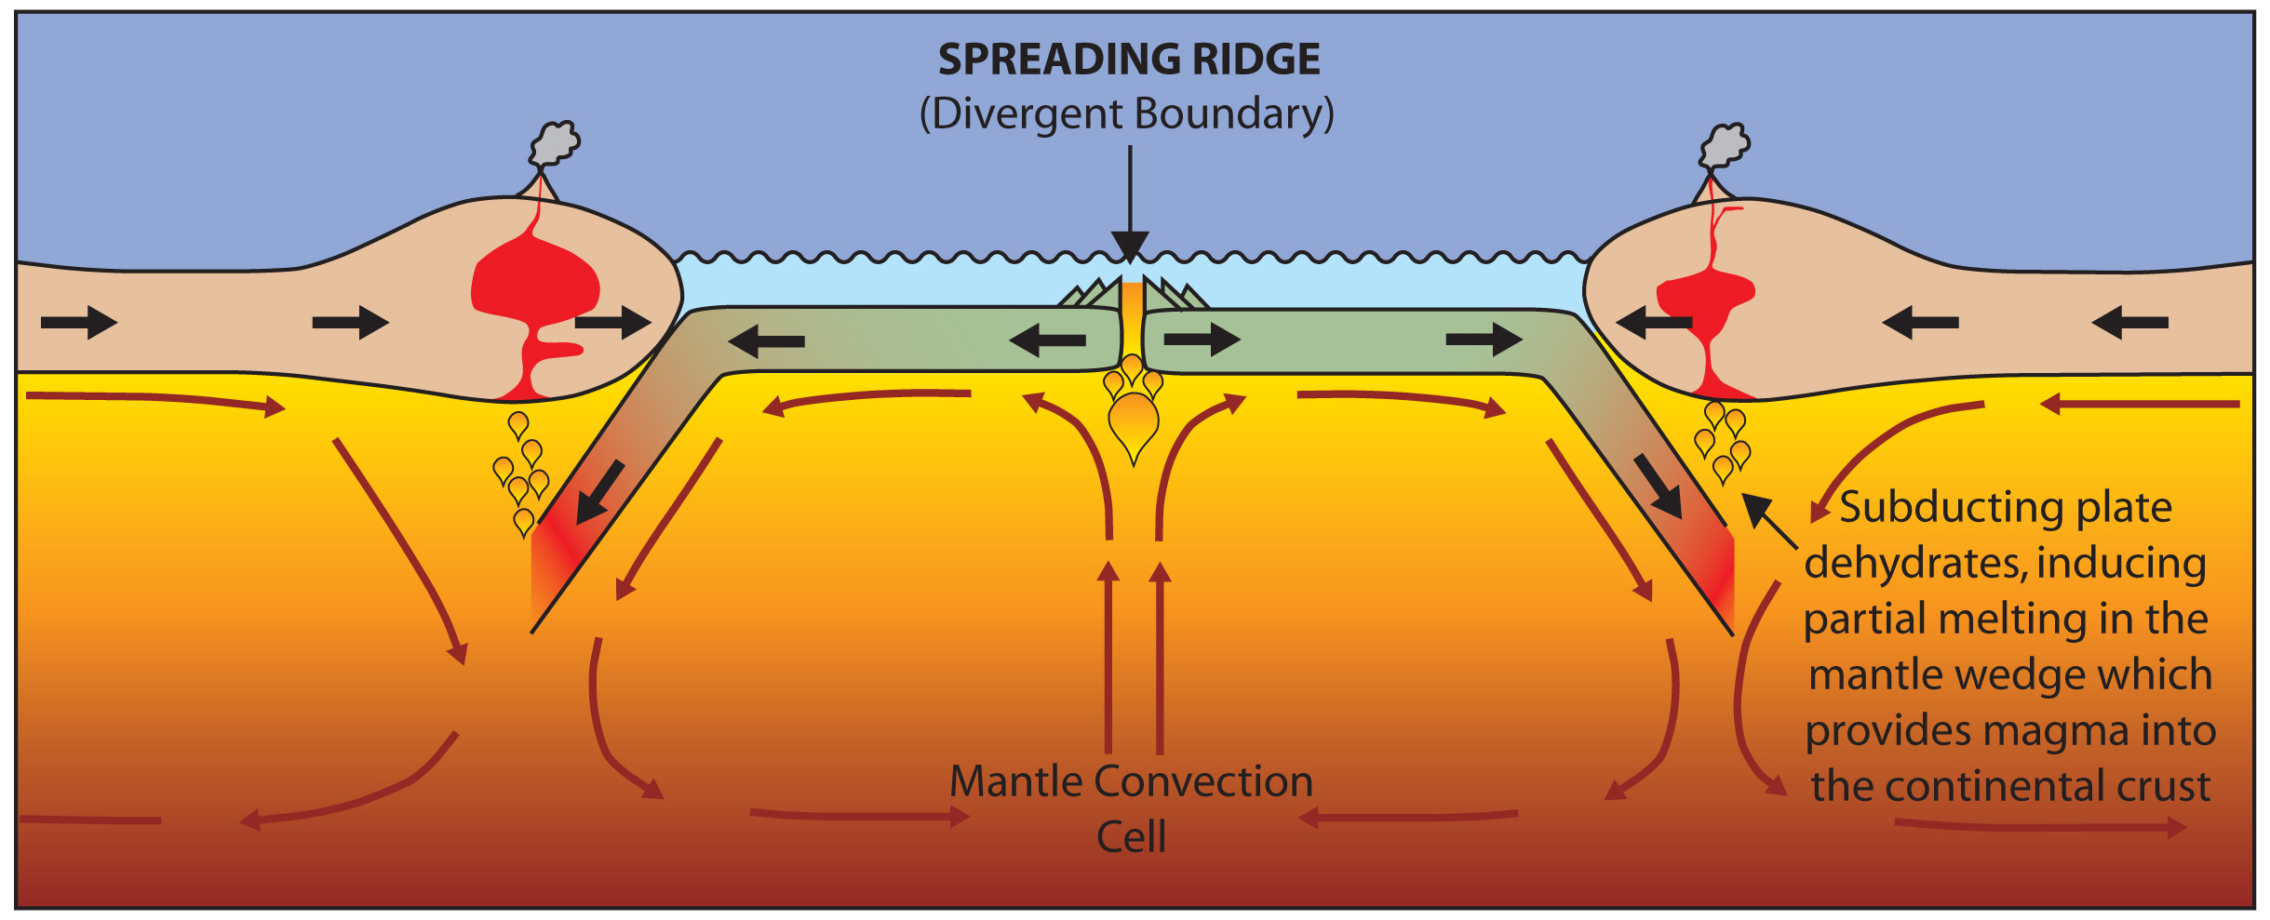
DIVERGENT BOUNDARIES
Ridges - As plates move apart new material is erupted to fill the gap
Notes:
In plate tectonics, a divergent boundary is a linear feature that exists between two tectonic plates that are moving away from each other. These areas can form in the middle of continents or on the ocean floor.
As the plates pull apart, hot molten material can rise up this newly formed pathway to the surface - causing volcanic activity.
Presenter: Reiterate the process by going through the diagram, including the presence of mantle convection cells causing the plates to break apart and also as a source for new molten material.
Where a divergent boundary forms on a continent it is called a RIFT or CONTINENTAL RIFT, e.g. African Rift Valley.
Where a divergent boundary forms under the ocean it is called an OCEAN RIDGE.

Slide 5
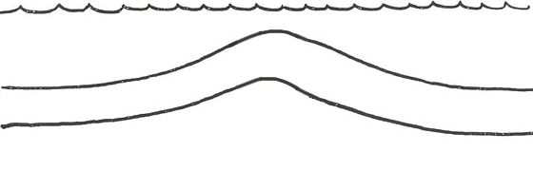
DIVERGENT BOUNDARIES
Ridges - As plates move apart new material is erupted to fill the gap
Notes:
In plate tectonics, a divergent boundary is a linear feature that exists between two tectonic plates that are moving away from each other. These areas can form in the middle of continents or on the ocean floor.
As the plates pull apart, hot molten material can rise up this newly formed pathway to the surface - causing volcanic activity.
Presenter: Reiterate the process by going through the diagram, including the presence of mantle convection cells causing the plates to break apart and also as a source for new molten material.
Where a divergent boundary forms on a continent it is called a RIFT or CONTINENTAL RIFT, e.g. African Rift Valley.
Where a divergent boundary forms under the ocean it is called an OCEAN RIDGE.

Slide 6
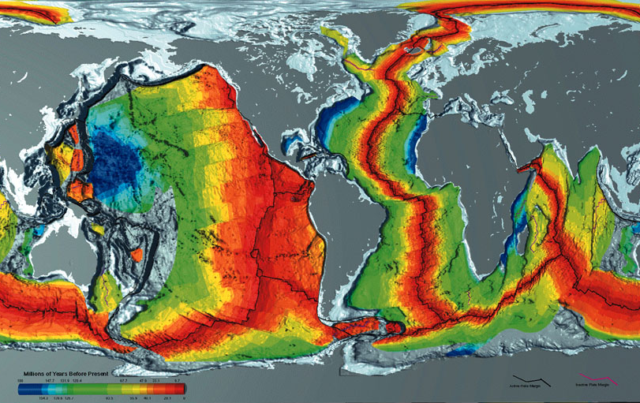
DIVERGENT BOUNDARIES
Age of Oceanic Crust
Courtesy of www.ngdc.noaa.gov
Notes:
Ocean Ridges: This map shows the age of the oceanic crust. The red colouring shows the youngest ages, whilst the dark blue shows the oldest ages (around 200 million years old).
Presenter ask: Where are the Ocean Ridges located? I.e. where are the divergent boundaries?
Answer: The divergent boundaries are where the plates are pulling apart and new material is being produced. Therefore the Ocean ridges are in the middle of the red areas (the boundaries are in fact shown on the map). We can see a progression of the oceanic crust getting older away from the ocean ridges (like a conveyer belt).
Presenter: Before moving on to the next slide, point out Iceland. The divergent boundary runs straight through Iceland….

Slide 7
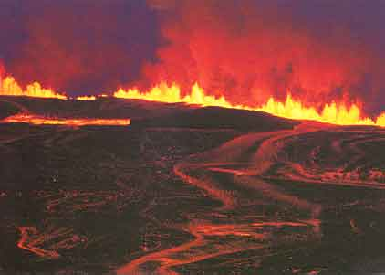
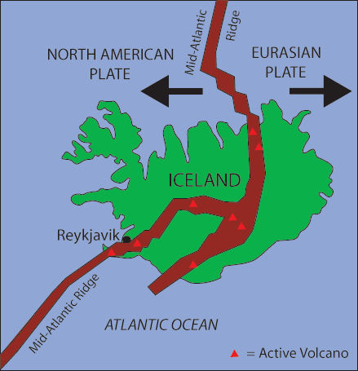
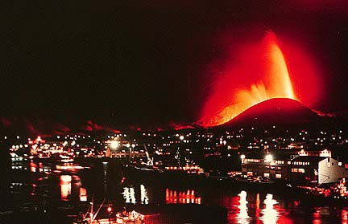
DIVERGENT BOUNDARIES
Iceland: An example of continental rifting
Iceland has a divergent plate boundary running through its middle
Notes:
Iceland is located right on top of a divergent boundary. In fact, the island exists because of this feature.
As the North American and Eurasian plates were pulled apart (see map) volcanic activity occurred along the cracks and fissures (see photographs).
With many eruptions over time the island grew out of the sea!
Question: Why don’t we have islands like Iceland where ever we get an Ocean Ridge?
Answer: Scientists believe that there is a large mantle plume (an upwelling of hot mantle material) located right underneath where Iceland has formed. This would mean that more material would be erupted in the Iceland area compared with if there was just the divergent boundary without the plume underneath it.

Slide 8
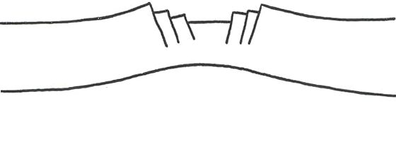
DIVERGENT BOUNDARIES
Continental Rifting
Iceland has a divergent plate boundary running through its middle
Notes:
Iceland is located right on top of a divergent boundary. In fact, the island exists because of this feature.
As the North American and Eurasian plates were pulled apart (see map) volcanic activity occurred along the cracks and fissures (see photographs).
With many eruptions over time the island grew out of the sea!
Question: Why don’t we have islands like Iceland where ever we get an Ocean Ridge?
Answer: Scientists believe that there is a large mantle plume (an upwelling of hot mantle material) located right underneath where Iceland has formed. This would mean that more material would be erupted in the Iceland area compared with if there was just the divergent boundary without the plume underneath it.

Slide 9
CONVERGENT BOUNDARIES
Iceland has a divergent plate boundary running through its middle
Convergent
Colliding
Canary Yellow
A plate boundary where two tectonic plates are colliding into each other.
Landforms
Volcanoes
Folded Mountains
Subduction Zones
Trenches
Volcanic Islands
Notes:
Iceland is located right on top of a divergent boundary. In fact, the island exists because of this feature.
As the North American and Eurasian plates were pulled apart (see map) volcanic activity occurred along the cracks and fissures (see photographs).
With many eruptions over time the island grew out of the sea!
Question: Why don’t we have islands like Iceland where ever we get an Ocean Ridge?
Answer: Scientists believe that there is a large mantle plume (an upwelling of hot mantle material) located right underneath where Iceland has formed. This would mean that more material would be erupted in the Iceland area compared with if there was just the divergent boundary without the plume underneath it.

Slide 10
CONVERGENT BOUNDRIES
“COLLIDING”
Notes:
Convergent boundaries are where the plates move towards each other.
There are three types of convergent boundary, each defined by what type of crust (continental or oceanic) is coming together.
Therefore we can have: continent-continent collision, continent-oceanic crust collision or ocean-ocean collision….

Slide 11
CONVERGENT BOUNDRIES
There are three styles of convergent plate boundaries
Continent-Continent Collision
Continent-Oceanic Crust Collision
Ocean-Ocean Collision
Notes:
Convergent boundaries are where the plates move towards each other.
There are three types of convergent boundary, each defined by what type of crust (continental or oceanic) is coming together.
Therefore we can have: continent-continent collision, continent-oceanic crust collision or ocean-ocean collision….

Slide 12
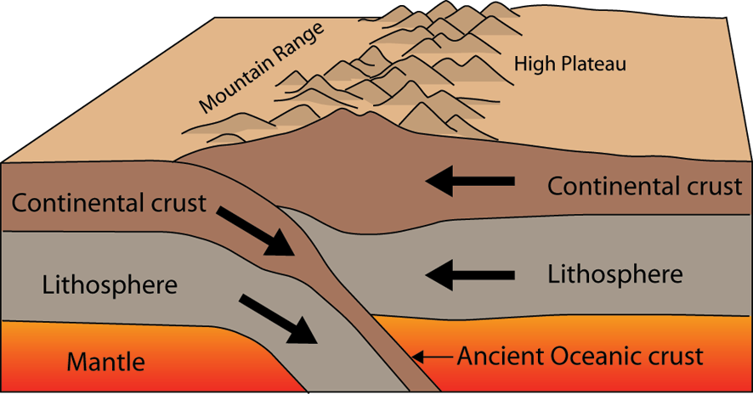
CONVERGENT BOUNDRIES
Continent-Continent Collision
Forms mountains, e.g. European Alps, Himalayas
Notes:
When continental crust pushes against continental crust both sides of the convergent boundary have the same properties (think back to the description of continental crust: thick and buoyant). Neither side of the boundary wants to sink beneath the other side, and as a result the two plates push against each other and the crust buckles and cracks, pushing up (and down into the mantle) high mountain ranges. For example, the European Alps and Himalayas formed this way.

Slide 13
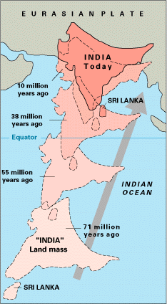
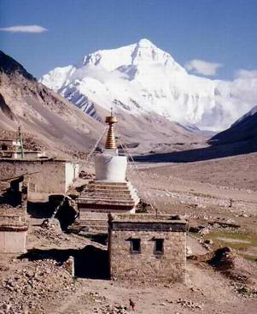
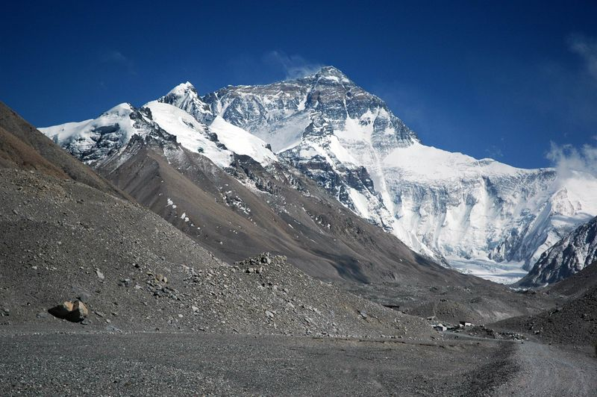
CONVERGENT BOUNDRIES
Himalayas
Notes:
Example:
India used to be an island, but about 15 million years ago it crashed into Asia (see map).
As continental crust was pushing against continental crust the Himalayan mountain belt was pushed up.
“Mountains” were also pushed down into the mantle as the normally 35 km thick crust is approximately 70 km thick in this region.
Mt Everest is the highest altitude mountain on our planet standing 8,840 metres high. This means that below the surface at the foot of the mountain the crust is a further 61 km deep!!

Slide 14
CONVERGENT BOUNDRIES
Continent-Continent Collision
Forms mountains, e.g. European Alps, Himalayas
Folded Mountains - mountains that form mainly by the effects of folding between convergent continental plates.
Notes:
When continental crust pushes against continental crust both sides of the convergent boundary have the same properties (think back to the description of continental crust: thick and buoyant). Neither side of the boundary wants to sink beneath the other side, and as a result the two plates push against each other and the crust buckles and cracks, pushing up (and down into the mantle) high mountain ranges. For example, the European Alps and Himalayas formed this way.

Slide 15
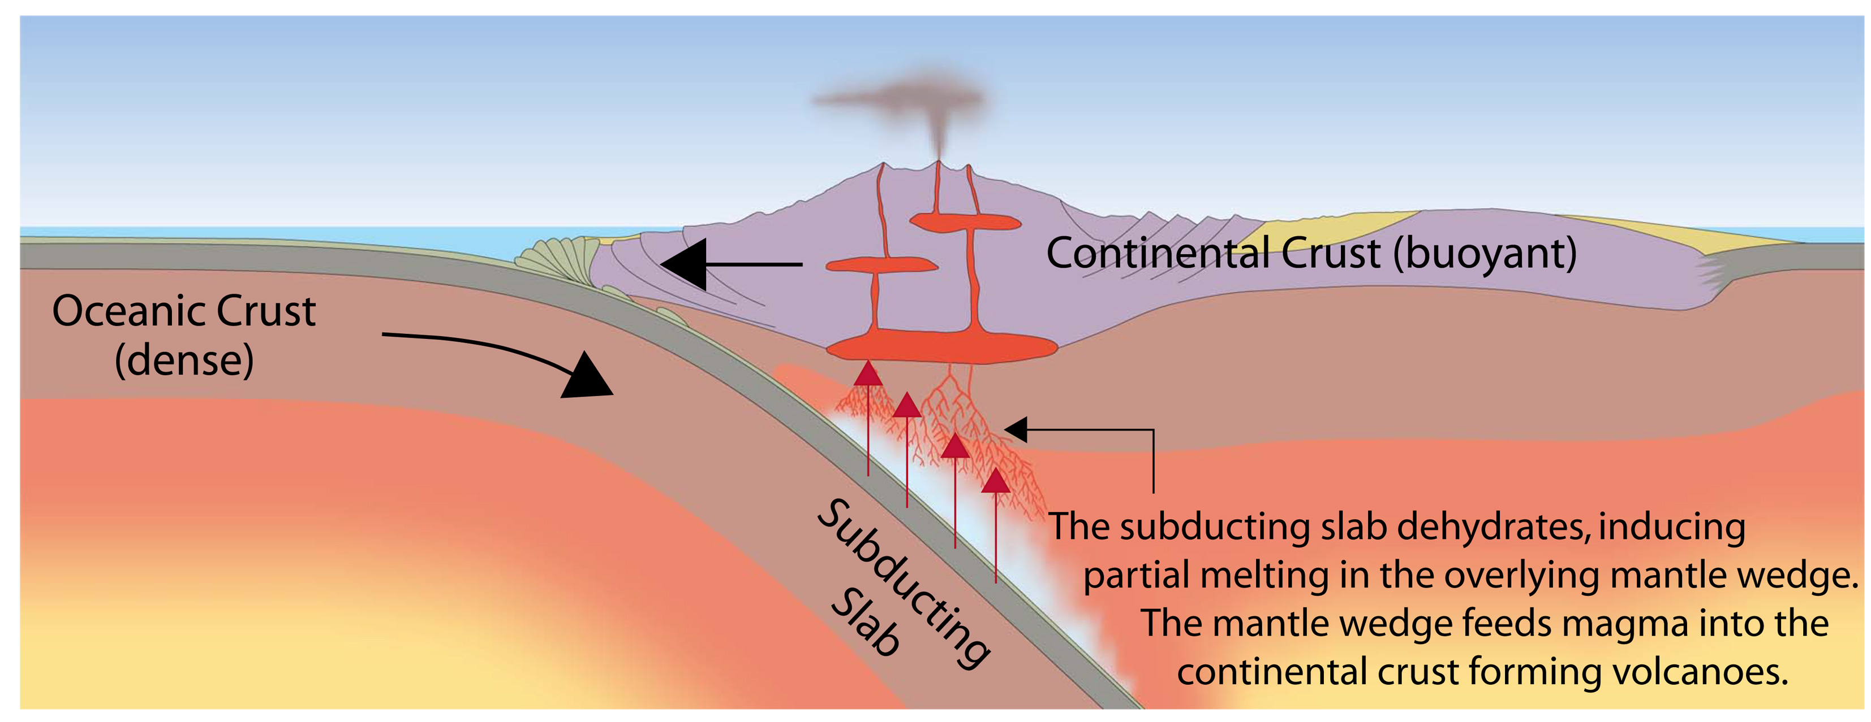
CONVERGENT BOUNDRIES
Continent-Oceanic Crust Collision
Called SUBDUCTION
Notes:
At a convergent boundary where continental crust pushes against oceanic crust, the oceanic crust which is thinner and more dense than the continental crust, sinks below the continental crust.
This is called a Subduction Zone.
The oceanic crust descends into the mantle at a rate of centimetres per year. This oceanic crust is called the “Subducting Slab” (see diagram).
When the subducting slab reaches a depth of around 100 kilometres, it dehydrates and releases water into the overlying mantle wedge (Presenter: explain all of this using the diagram).
The addition of water into the mantle wedge changes the melting point of the molten material there forming new melt which rises up into the overlying continental crust forming volcanoes.
Subduction is a way of recycling the oceanic crust. Eventually the subducting slab sinks down into the mantle to be recycled. It is for this reason that the oceanic crust is much younger than the continental crust which is not recycled.

Slide 16
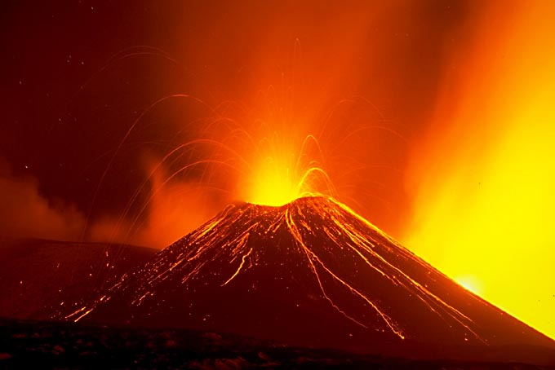
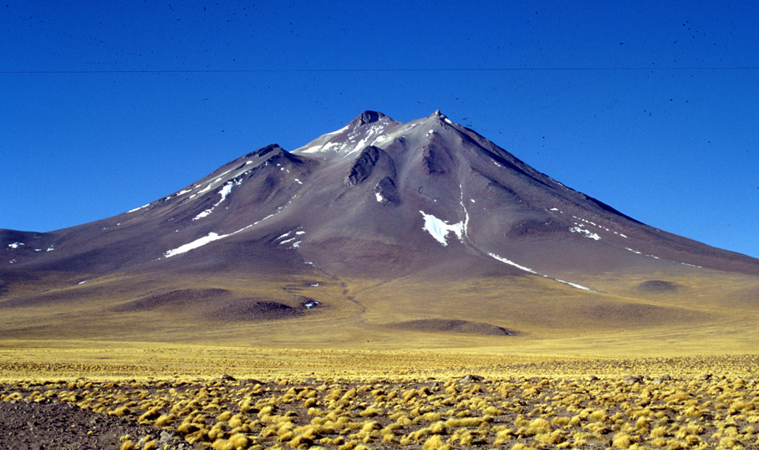
CONVERGENT BOUNDRIES
Subduction
ZONE
collision of the earth's crustal plates results in one plate's being drawn down or overridden by another.
Oceanic lithosphere subducts underneath the continental lithosphere
Oceanic lithosphere heats and dehydrates as it subsides
The melt rises forming volcanism
E.g. The Andes
Notes:
The Andes mountain range along the western edge of the South American continent is an example of a mountain belt formed by subduction.
The continental crust of the South American plate has buckled under the compressional strain of converging with the Nasca and Antarctic plates. Additionally there are many volcanoes, the result of melting of the subducting slab and the production of new material that has risen through the crust to the surface.

Slide 17
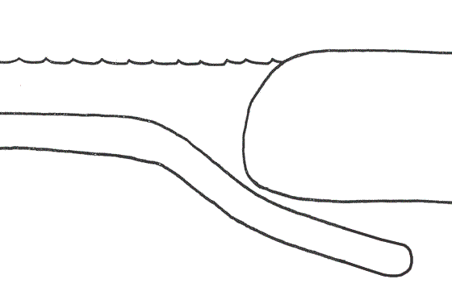
CONVERGENT BOUNDRIES
Continent-Oceanic Crust Collision
Called SUBDUCTION
Notes:
At a convergent boundary where continental crust pushes against oceanic crust, the oceanic crust which is thinner and more dense than the continental crust, sinks below the continental crust.
This is called a Subduction Zone.
The oceanic crust descends into the mantle at a rate of centimetres per year. This oceanic crust is called the “Subducting Slab” (see diagram).
When the subducting slab reaches a depth of around 100 kilometres, it dehydrates and releases water into the overlying mantle wedge (Presenter: explain all of this using the diagram).
The addition of water into the mantle wedge changes the melting point of the molten material there forming new melt which rises up into the overlying continental crust forming volcanoes.
Subduction is a way of recycling the oceanic crust. Eventually the subducting slab sinks down into the mantle to be recycled. It is for this reason that the oceanic crust is much younger than the continental crust which is not recycled.

Slide 18
CONVERGENT BOUNDRIES
Ocean-Ocean Plate Collision
Notes:
When two oceanic plates converge, because they are dense, one runs over the top of the other causing it to sink into the mantle and a subduction zone is formed.
The subducting plate is bent down into the mantle to form a deep depression in the seafloor called a trench.
Trenches are the deepest parts of the ocean and remain largely unexplored.

Slide 19
CONVERGENT BOUNDRIES
Ocean-Ocean Plate Collision
When two oceanic plates collide, one runs over the other which causes it to sink into the mantle forming a subduction zone.
The subducting plate is bent downward to form a very deep depression in the ocean floor called a trench.
The worlds deepest parts of the ocean are found along trenches.
E.g. The Mariana Trench is 11 km deep!
Notes:
When two oceanic plates converge, because they are dense, one runs over the top of the other causing it to sink into the mantle and a subduction zone is formed.
The subducting plate is bent down into the mantle to form a deep depression in the seafloor called a trench.
Trenches are the deepest parts of the ocean and remain largely unexplored.

Slide 20
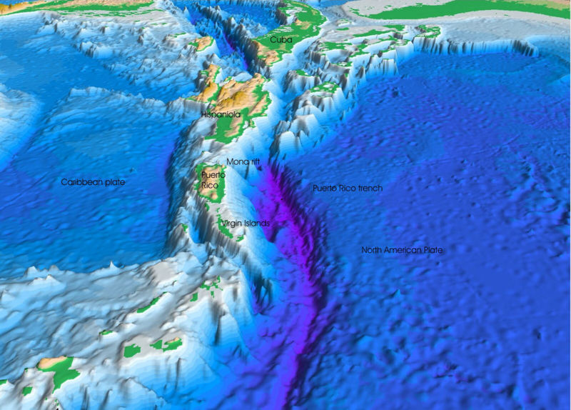
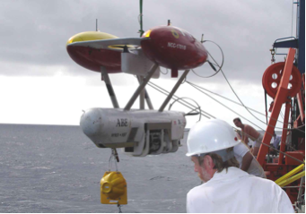
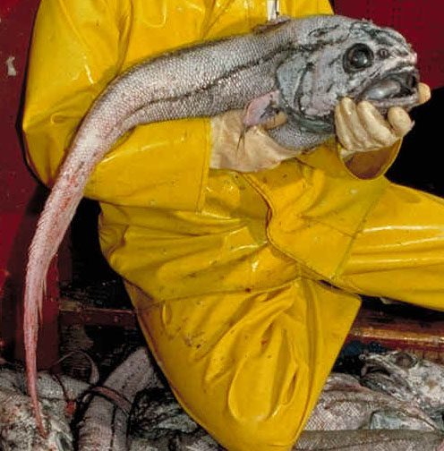
CONVERGENT BOUNDRIES
MARIANA
TRENCH
Notes:
Manned or unmanned submersible vehicles (top right photo) have explored small parts of trenches discovering new species (like the fish photographed here) and amazing ecosystems.

Slide 21
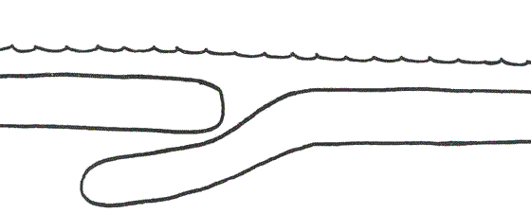
CONVERGENT BOUNDRIES
Ocean-Ocean Plate Collision
Notes:
When two oceanic plates converge, because they are dense, one runs over the top of the other causing it to sink into the mantle and a subduction zone is formed.
The subducting plate is bent down into the mantle to form a deep depression in the seafloor called a trench.
Trenches are the deepest parts of the ocean and remain largely unexplored.

