Slide 1
Expectations
7th Grade Science Distance Learner

Slide 2
This new for all of us
This is new for you
Everything your teachers are doing for you is new for them
This is new for the whole county
We are doing everything we can to ensure that your education meets the highest standard
If you have yet to receive instruction on anything, we do not expect it of you yet
We will make sure you are prepared for anything we ask you to do
Everything in the school this week is about expectations and procedures
Everything online this week will be setting you up with basic expectations and procedures
You are not behind
Be patient

Slide 3
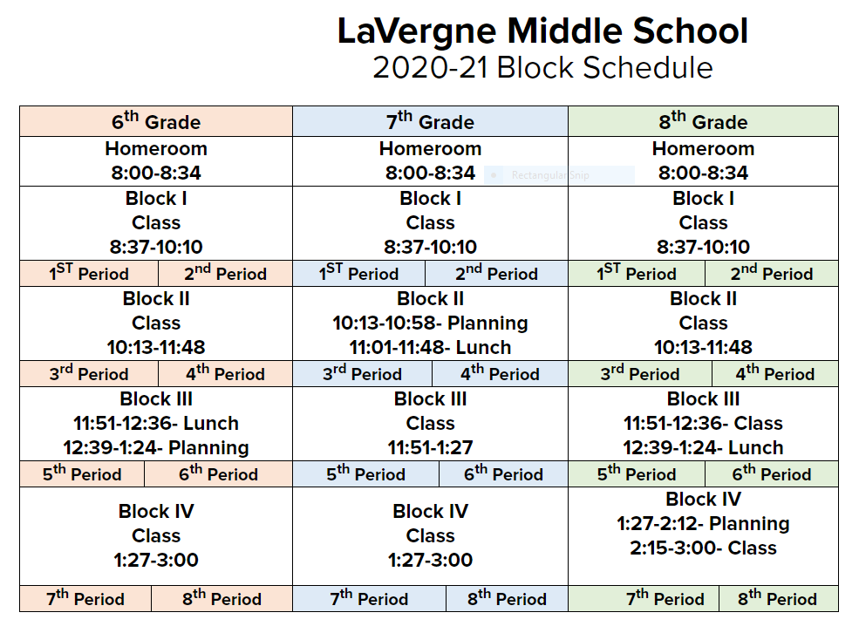
LMS Schedule
If your Skyward schedule says that you have Science 1st, 5th, or 7th, you have me Monday, Wednesday and Friday
If your Skyward schedule says that you have Science 2nd, 6th, or 8th, you have me Tuesday, Thursday and Friday
Expect to receive three lessons per week.

Slide 4
Assignments
Unless otherwise stated, all assignments are due by the end of the day they are assigned

Slide 5
Office Hours and Live Streaming
I do not yet know if I will be live for office hours this first week. Instructions on how to tune in will be coming soon. When I am available, my hours are as follows:
OFFICE HOURS: Live on Zoom for questions on Thursdays from 10:35-10:55
I do know that I have a meeting in the school this week during this time so I will not be available THIS week.
Live Streaming from the Classroom: Live on Zoom Mondays and Wednesdays for 20 minutes during scheduled class times.
On Mondays, students who have me both Monday and Tuesday will tune in.
On Wednesdays, student who have me both Wednesday and Thursday will tune in.

